Slide 1
BASICS OF HALAL CERTIFICATION
Globally and Locally in Pakistan
Saeed Akhtar Dr.
Nippon Asia Halal Association (NAHA) www.nipponasia-halal.org
info@nipponasia-halal.org
Tel:03-5413-8418,090-4227-8314

Slide 2
Agenda
Basics of Halal
Shariah Law
Al Quraan explanation
Taqwa & Halal
Purpose of Halal Certification
Halal Mark
Science behind Halal Certification

Slide 3
Agenda
World’s famous Halal Certification and Accreditation Bodies
General Procedure of Halal Certification
Fee to get Halal Certificate
Documents Required to get Halal Certificate
Halal Certification as Business
Major Halal Producing and Buyer countries
Halal in Pakistan
Halal in the world

Slide 4
Basics of Halal
Halal = حلال
Meaning : lawful, Permissible, allowed as per certain law
Allowed according to Islamic Law (Things and actions)

Slide 5
Shariah Law
What is Shariah law and How it is being made and used in Islam。
1- Al-Qur’an
2- Hadith
3- Ijma
4- Qiyas

Slide 6
How Al-Quraan explains Halal
第2章173
① Dead Meat： ② Blood
③ Pork：
④ Any halal animal slaughtered by the name of any other God except ALLAH

Slide 7
Relationship of Taqwa with Halal
T
AAQWA
H
A
L
AL
Taqwa=Result of Love

Slide 8
How Al Quraan explains Taqwa
Surah 49 Ayat 13
[Translation] O mankind! We have created you from a male and a female, and made you into nations and tribes, that you may know one another. Verily, the most honorable of you with Allah is that (believer) who has Taqwa. Verily, Allah is All-Knowing, All-Aware.”

Slide 9
Why Halal Certification is Necessary
① Halal : As per certain law (Its clear)
② Haram : Against law (Its clear)
③ Syubhah : Doubtful (Its not clear, needs traceability)

Slide 10
Halal Mark
Japan
NAHA
Arabic word （حلال）is there
Products guarantees its traceability
Products guarantees its safe
checked by third party

Slide 11
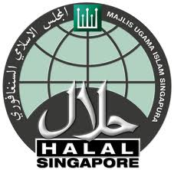
Examples of Halal Mark
Japan
NAHA
Indonesia
MUI
Malaysia
JAKIM
Singapore
MUIS

Slide 12
Science behind Halal Certification
Animal Source
Plant
Base of
Halal
Microbes
Man Made, GMO

Slide 13
World Certification & accreditation Bodies
Every country has its own system of certification
Famous countries which are leading are Malaysia, Indonesia, Singapore, UAE, Turkey, Pakistan, Thailand
In Japan There are three Famous Religious organizations,
Japan Muslim Association, JMA 1960s
Islamic Center Japan 1960s
Japan Islamic Trust 1999
Five NPOs
Japan Halal Association, JHA 2010
Nippon Asia Halal Association, NAHA 2010
Muslim Professional Japan Association (MPJA) 2014
Japan Halal Unit Association (JHUA) 2015
Japan Halal Foundation (JHF)

Slide 14
How to get Halal Certificate
Mail or Tel or meeting
↓
Information about Ingredients
↓
Pre-Audit
↓
Audit
↓
Audit Report,
↓
Halal Certification
↓
Surveillance

Slide 15
Fee to get Halal Certificate
Advice and Discussion
Pre Audit
Halal Consulting
Halal Training
Mostly done by consultant companies
Halal Certification Full Audit
Renewal Fee
Done by Accredited Certification Body

Slide 16
Documents Required
LIST OF PRODUCTS TO BE CERTIFIED
LIST OF INGREDIENTS
DETAIL OF INGREDIENTS
FLOW CHART
COMPANY REGISTRATION
COMPANY LICENCE TO PRODUCE FOOD ITEM
PRODUCTION RECORD
INVENTORY RECORD
PROCESSING RECORD
FILLING AND PACKING RECORD
DISPATCH RECORD
HALAL MARK RECORD
HALAL TEAM MEMBERS
ISLAMIC ADVISOR CONTRACT
HALAL THREATS
CLAIM RECORD
CHANGES IN SYSTEM
SOP
RECORD OF QUALITY CONTROL
CLAIM RECORD

Slide 17
Halal Certification as business

Slide 18
What for “Halal Certification”
Food & Beverages
Ingredients
Processing
Logistics
Medicines,
Cosmetics

Slide 19
Halal as Business
All Businesses are based on major principles of
DEMAND and SUPPLY
INFRASTRUCTURE
TRUST
POLITICS
Halal Business has demand all over the world
Supply level varies from region to region

Slide 20
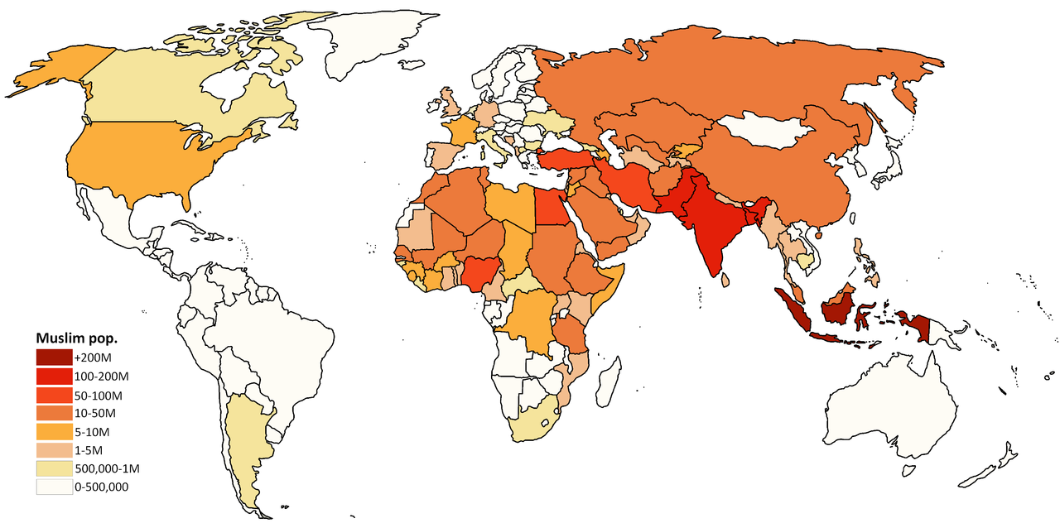
Muslim Population around the world
Among Muslim Countries Indonesia, Pakistan
and Bangladesh are thick Muslim population countries
Among Non Muslim Countries India, China are big
Muslim populated countries

Slide 21
Major Halal Producing & Buyer countries
Producer:
America, Canada, Brazil, Australia, New Zealand, Singapore, China, Thailand, India, France, Germany, England, Norway, Finland, South Africa
Malaysia, Turkey, Pakistan, Indonesia
Buyer:
Malaysia, Indonesia, UAE, Saudi Arabia, Singapore, Thailand, India, Bangladesh, Turkey, Pakistan

Slide 22
Halal in Pakistan
A- History of Halal in Pakistan
B- As Infrastructure
Standards
Education
Awareness
Certification Bodies
Accreditation
Trust ＆ Relationship to the world
C- As Business
Awareness to consumers
Education to Industry
Trust & Relationship to the world

Slide 23
Halal in the World
1- As Business
Its 3 Trillion USD business in the world
Its growing
2- As Politics
No unified or harmonized standards
Each country wants to be leader, while no body is the leader
3- As Infrastructure

Slide 24
QUESTION AND ANSWER

Slide 25
Thank You.
ありがとうございました。

